Slide 1
IPR
Cadets William Born and Kayleigh Stallings

Slide 2
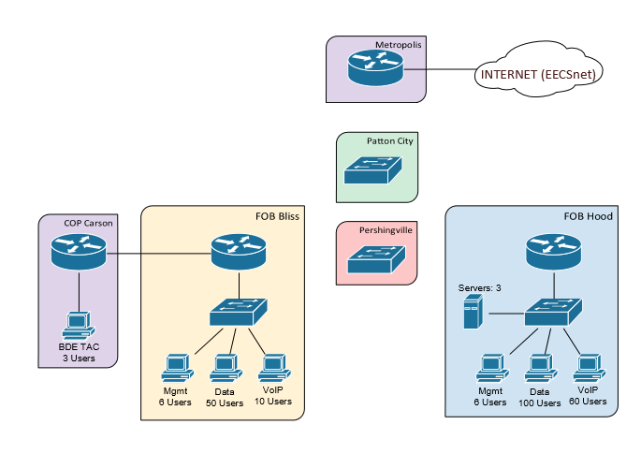
Network Overview

Slide 3
Requirements
All users need internet access
If a link is cut between FOB Bliss and Pershingvill, FOB Bliss should sill have access to all other sites
BDE TAC wants Wi-Fi
Internal users have access to 2 web servers and a DNS server
Only appropriate traffic should be sent to each server
No users from the outside should be able to access the servers or ping the network

Slide 4
Constraints
IP Space= 10.64.62.0/24
Metropolis router IP = 10.64.0.62/24
OSPF must be used between main sites and COP

Slide 5

Network Diagram
Fa0/1
Fa0/0
Fa0/0.100: 10.64.62.10
Fa0/0.200: 10.64.62.20
Fa0/0.300: 10.64.62.30
Fa0/0.500: 10.64.62.50
Fa0/1 10.64.0.62
Default Gateway: 10.64.0.64
Fa0/0: 10.64.62.2/24
Fa1/0: 10.64.62.6/24
Fa1/1: 192.168.74.139/31
Fa0/1.200:192.168.74.127/25
Fa0/1.500:192.168.74.126/25
VLAN 200
VLAN 500
IP:10.64.62.4/24
Fa0/0: 192.168.64.138/31
Fa0/1:192.168.74.133/29
VLAN 300
Fa1/0
Fa0/0: 10.64.62.1/24
Fa0/0: 10.64.62.7/24
Fa0/1.100:192.168.64.251/24
Fa0/1.500:192.168.64.252/24
VLAN 100
VLAN 500
Fa0/0
Fa0/0
Fa1/1
IP:192.168.74.132/29
VLAN 300
Default Gateway:
192.168.74.133
Fa0/0
Fa1/0
Fa0/1
Fa0/1
Fa0/1
IP:10.64.62.3/24
IP:192.168.74.129-132/29
VLAN 300
Default Gateway:
192.168.74.133
IP1:192.168.64.3/24
IP2:192.168.64.4/24
IP3:192.168.64.5/24
IP1:10.64.62.13/24
IP2:10.64.62.14/24
IP3:10.64.62.15/24
VLAN 100
Default Gateway:
192.168.64.251
IP:192.168.64.2/24
IP:192.168.64.6-65/24
VLAN 100
Default Gateway:
192.168.64.251
IP:192.168.74.61-67/25
VLAN 500
Default Gateway:
192.168.74.126
IP:192.168.74.11-60/25
VLAN 200
Default Gateway:
192.168.74.127
IP:192.168.74.1-10/25
VLAN 200
Default Gateway:
192.168.74.127
IP:192.168.64.166-.171/24
VLAN 500
Default Gateway:
192.168.64.252
IP:192.168.64.66-165/24
VLAN 100
Default Gateway:192.168.64.251

Slide 6
Subnetting Chart
Private Addresses
Location | Network | Subnet Mask | Usable Range | Broadcast
FOB HOOD | 192.168.64.0 | 255.255.255.0 | 192.168.64.1-.255 | 192.168.64.256
FOB BLISS | 192.168.74.0 | 255.255.255.128 | 192.168.74.1-.126 | 192.168.74.127
COP CARSON | 192.168.74.128 | 255.255.255.248 | 192.168.74.129-.135 | 192.168.74.136
Router to Router | 192.168.74.137 | 255.255.255.252 | 192.168.74.138-.139 | 192.168.74.140
Public Addresses
Location | Network
FOB HOOD | 10.64.62.1 10.64.62.7
FOB BLISS | 10.64.62.2 10.64.62.6
Location | Network
FOB BLISS Servers | 10.64.62.13 10.64.62.14 10.64.62.15
Location | Network
Pershingville | 10.64.62.3
Patton | 10.64.62.4
Metropolis | 10.64.62.5
Network will utilize PAT to save the limited IP space

Slide 7
VLAN Configuration
VLAN Number | VLAN Name | IP on Metropolis
500 | Management | 10.64.62.50
100 | FOB HOOD | 10.64.62.10
200 | FOB BLISS | 10.64.62.20
300 | COP CARSON | 10.64.62.30

Slide 8
Routing
Will implement ospf dynamic routing protocol
For each router
Router(config)#router ospf 1
Router(config-router)#network 10.64.62.0 0.0.0.255 area 0
As well as loopbacks
Each router will also configure their own internal ip space using ospf
Router(config-router)#network 192.168.64.0 0.0.0.255 area 0
Router(config-router)#network 192.168.74.0 0.0.0.129 area 0
Router(config-router)#network 192.168.74.128 0.0.0.9 area 0
Each router will have default route set to next router

Slide 9
ACLS, NAT and wireless
PAT
All user computers will be covered using PAT, so that traffic from each comes through one public address per router
Dynamic NAT
Server private addresses will be translated to public addresses so that each can be individually address by all computers on the network.

Slide 10
ACLS, NAT and wireless
ACLS/Security
The metropolis router will implement the following rules:
No ICMP from outside the network (no pings)
No access to server addresses from outside the network
The FOB Hood router will implement the following rules
No access to port 22 expect for Management VLAN for the servers
Only access to ports on the servers for relevant services for all computers on the network
All routers will be configured to only accept SSH and all passwords will by encrypted

Slide 11
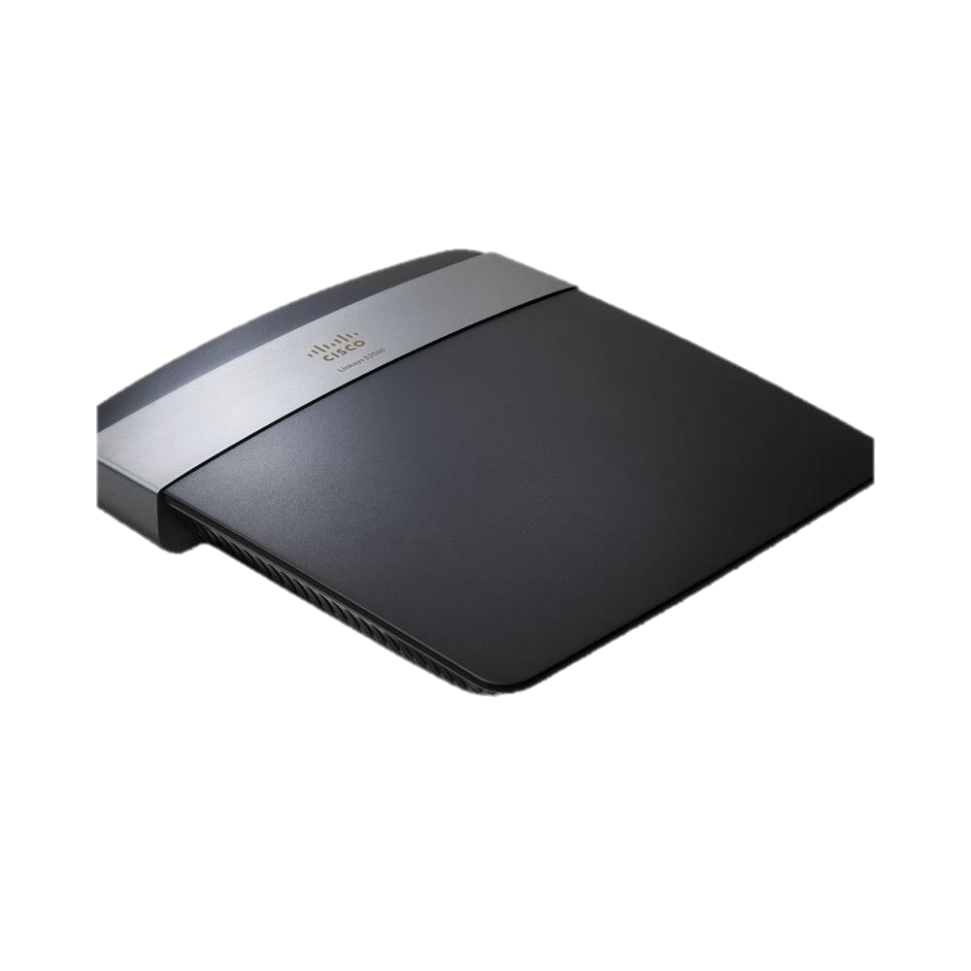
ACLS, NAT and wireless
Wireless
Wireless Router will be given one private range ip address at COB Carson
Since the purpose of the router is for personal internet connectivity, PAT will be implemented so that all devices on the Router are translated to the one private ip at COB Carson
The router has DHCP, so configuration of each host on the wireless is unnecessary.
Wireless network secured with WPA2

Slide 12
Questions?

